Slide 1
ChIP Sequencing
Alex Sánchez

Slide 2
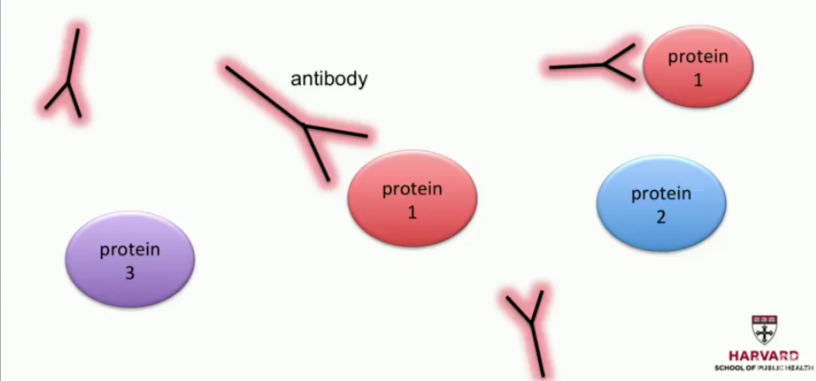
Reminder: Chromatin Immunoprecipitation (ChIP)
Notes:
So how does ChIP-seq work?
So we first have to decide which of the many proteins we can measure is of interest. So in this cartoon,
we're showing you three possible proteins, and we actually decided to measure the location of protein
one. So what we do first is we design an antibody that will bind to that protein and not the others. Once
we have that, we can get going with the technique.

Slide 3
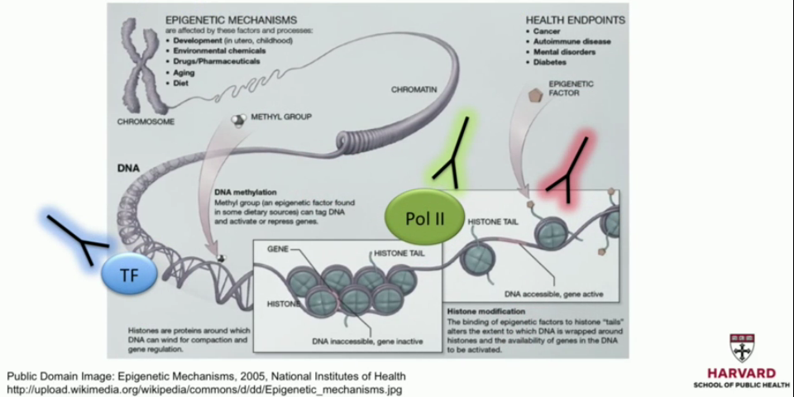
ChIP – seq targets
Notes:
So notice that the genome has many different kinds of proteins bound to it. Here we're showing you
three examples using a cartoon. And for all of these, we can design different antibodies that will attach
specifically to each one. So let's look at our cartoon demonstrating how this works.

Slide 4
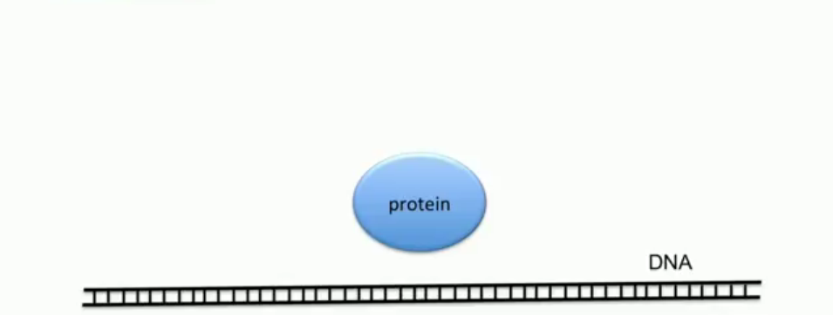
Natural state
Notes:
So here's a protein. We want to know that it's bound at that location. We can't see that under a
microscope, so we need some indirect way of measuring.

Slide 5
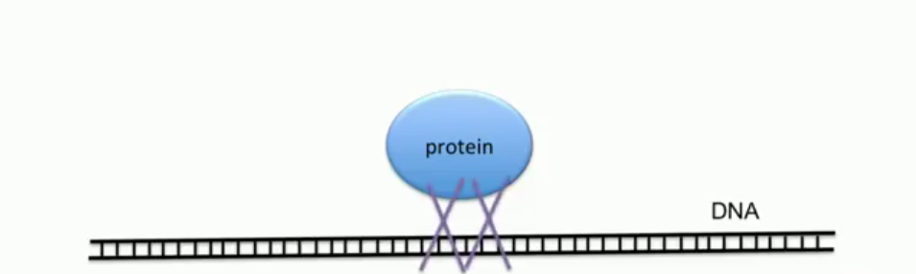
Crosslinking (e.g. with formaldehyde)
Notes:
So we use a technique called crosslinking,
which will make that protein stick to the genome.

Slide 6
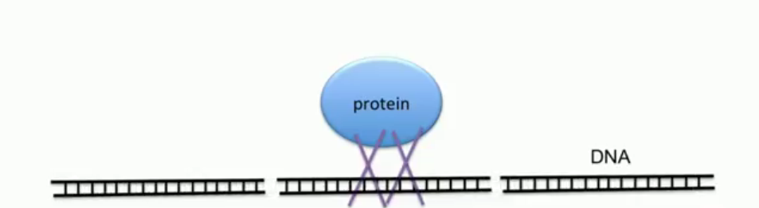
Fragmentation
Notes:
Then we are going to fragment the genome.

Slide 7
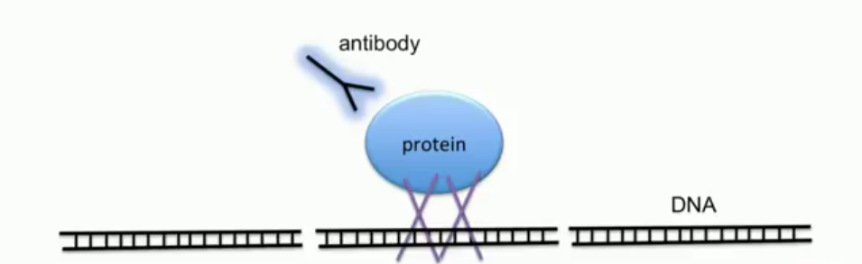
Add antibody
Notes:
And in the next step, we'll introduce the antibodies, which
will bind to these proteins. This permits us to pull down this piece of the genome.

Slide 8

Pull down (wash away the rest)
Notes:
Notice that the other
parts are not here anymore. We wash away the rest.

Slide 9

Reverse crosslink
Notes:
Then we perform a procedure called reverse crosslink where now the protein is no longer attached to
the piece of the genome, but we have that piece of the genome. And that gets sequenced.

Slide 10
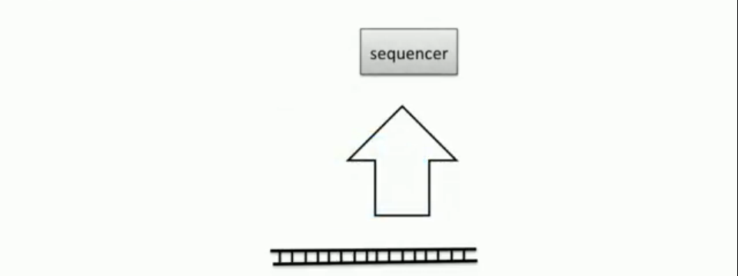
Amplify and sequence
Notes:
So when we
see this piece of the genome, we know that a protein was attached to it.

Slide 11
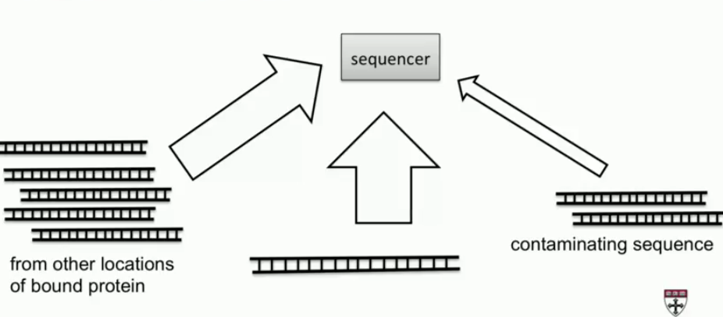
Amplify and sequence
Notes:
Now, in a real experiment, we're going to have pieces from the other parts of the genome where this
protein was bound, represented in this cartoon with those segments on the left, and we're also going to
have some contaminating sequence. This happens for several reasons, not all of them are known. But
1sequences that were not originally bound to the protein of interest show up in our data. It's very
common to see this.

Slide 12
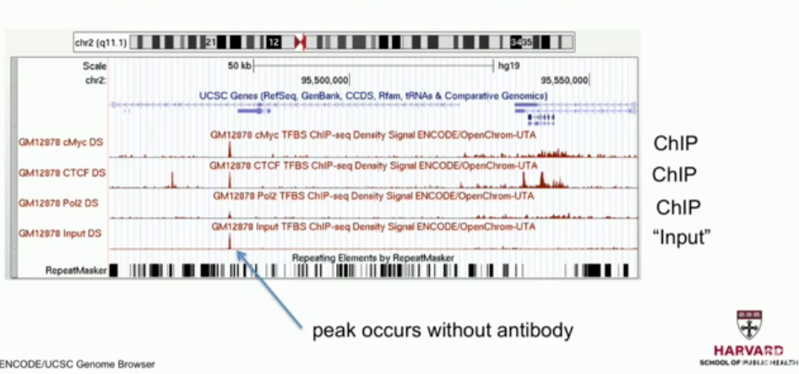
Repeat experiment without antibody (Input)
Notes:
So
here is data from several ChIP-seq experiments. We see an experiment here, an experiment here, an
experiment here. They're each performed using a different antibody. We're after a different protein. You
can see the proteins that were being targeted here on the left.
But there's another thing we see on this plot that shows us a little bit of a problem. We are also
including input DNA. Input DNA is DNA that is not treated with any antibody. So the entire genome
should show up on this track, and there should not be big peaks as we see in the data that has been
ChIPed. But notice this peak here.
We see a peak, and we see that peak again in the ChIP data. So that is probably a location of the
genome that is going to show reads no matter what we do. And we should be careful with that. So one
approach that is now very commonly applied is that we always run a control experiment to account for
biases such as this.

Slide 13
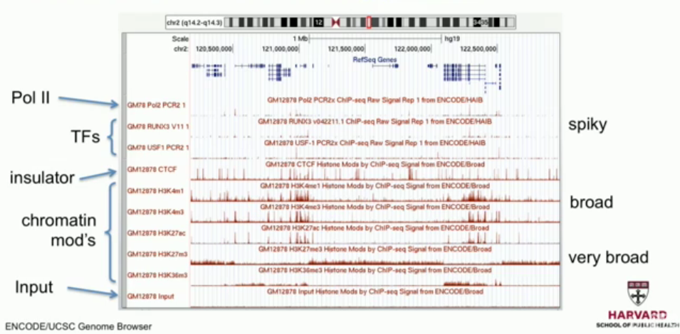
Proteins have different binding patterns
Notes:
Another characteristic we should be aware of when we analyze ChIP-seq data is that different proteins
will result in different patterns of peaks. Here we have an example showing you different proteins along
with the input. And we can see that some of the peaks are spiky, some of the peaks are broad, and
some of the peaks are very broad.
So when we design analysis tools, we have to take this into account. We're going to describe several
statistical techniques for dealing with the different kinds of peaks

Slide 14
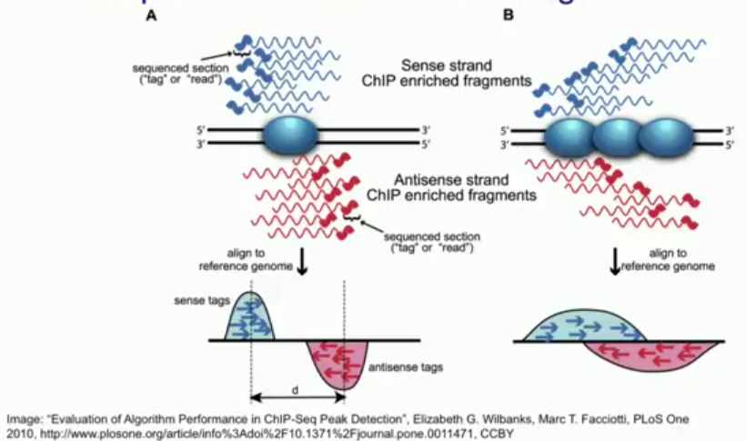
ChIP-seq tracks show shifted coverage
Notes:
Another important characteristic we
need to understand is that, for most ChIP-seq data that we get, we're going to get two strands.
We're going to have data coming from one strand, represented in this cartoon with blue, and the other
strand, represented in red. Now, because of the way the experiment works, what we're going to see in
the data is that, at the location where the protein was bound, we're going to see a peak slightly to the
left when we look at one strand and another peak slightly to the right for the other strand. Now, this is a
characteristic that algorithms designed to find peaks need to take into account. Otherwise, they will not
perform very well.

Slide 15
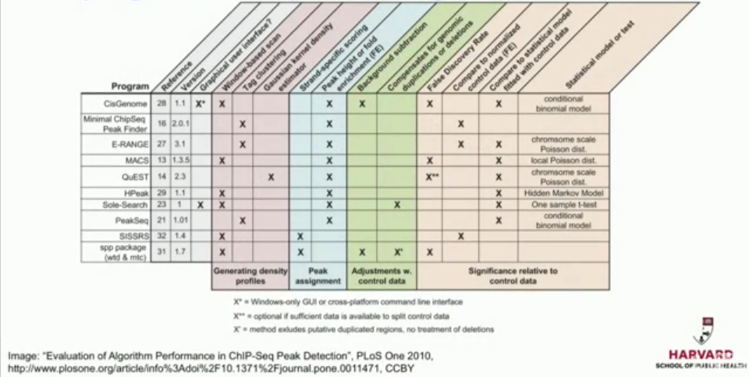
Many algorithms for peak finding
Notes:
In this slide, we're
showing you some of the most popular and some of the characteristics of these popular algorithms.
We're going to focus on one of them, MACS-- tell you a little bit about how that works. First, remember
that there's different kinds of peaks.

Slide 16
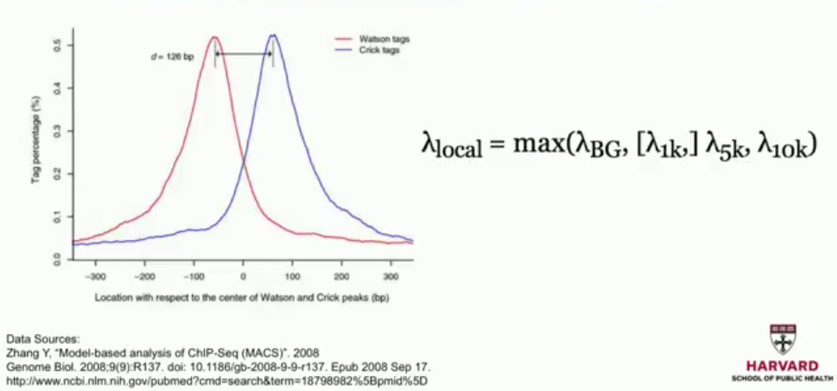
Model-based analysis of ChIP-Seq (MACS)
Notes:
There's the spikey ones and the broad and the very broad. MACS
is designed for the spikey peaks. In the first step, it makes an assumption of the type of peak that we
should observe, remembering that we have two peaks, one for each strand.
So it searches the genome for locations where we see peaks like this and it creates a list of candidate
regions. Once these candidate regions are found, then we have to decide if it's significant or not, if the
counts that we see in these regions is significantly different than what we would see by chance. So to
do this, it needs to create a background model.
So what it does is it assumes it's Poisson. But what's the rate of this Poisson? So MACS uses four
options and then it picks the maximums, as we'll describe in a second. The first thing it does is it
calculates the average rate of reads that we would see in the entire genome, the background rate of
the entire genome. And then it takes windows of size 1,000, 5,000 and 10,000, centered at the
candidate region's center. And it computes the rate in each one of these.
What this does is it gives us an opportunity to find small regions that have very high values, even in the
input channel, and it lets us discard these peaks because it has nothing to do with the protein being
bound or not. So once we have selected this lambda, then we go back to the candidate region and we
simply perform a hypothesis test using the Poisson model to ask the question, is the rate in the
candidate region different than the background rate? And that will give us a p-value for each peak.
Then you can use filters based on these p-values to decide what is called a peak and what is not. So
once you're done with this procedure, you end up with a series of regions that are determined to be
peaks.

